Slide 1


HAND GESTURE RECOGNITION TO IMPLEMENT
VIRTUAL MOUSE USING KERAS
by
MOIN MALIK
TAUFEEK MANSURI
(Roll no. 1829010099, 1829010097)
Under the Supervision of
Mr. K.B Dubey
Asstt. Professor
DEPARTMENT OF COMPUTER SCIENCE AND ENGINEERING
ABES INSTITUTE OF TECHNOLOGY GHAZIABAD
Affiliated to
DR. APJ ABDUL KALAM TECHNICAL UNIVERSITY

Slide 2
CONTENTS
1. INTRODUCTION
2. LITERATURE SURVEY
3. PROPOSED WORK
4. CONCLUSION

Slide 3
INTRODUCTION
1.Hand gestures can be effectively used in giving
commands to your computer.
2. The computer will capture the gesture, interpret it and take the appropriate action based on its previous inputs and data.
3. This makes our day to day tasks easy and enhance the human computer interaction over the regular text based commands and GUI.

Slide 4
LITERATURE SURVEY
HCI TECHNOLOGY
Human-computer interaction (HCI) is an area of research and practice that emerged in the early 1980s.
GESTURE RECIGNITION
Gesture recognition is the mathematical interpretation of a human motion by a computing devices.

Slide 5
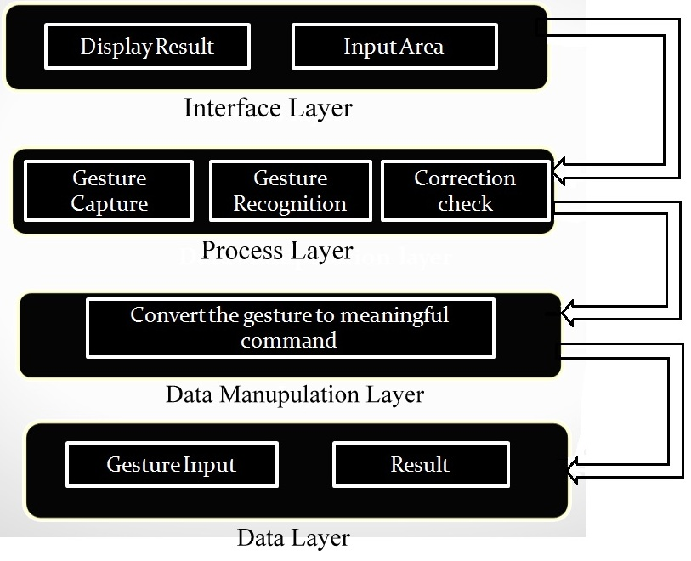
PROPOSED WORK

Slide 6
CONCLUSION.
We are developing a system to control the mouse cursor using a real-time camera.
This system is based on computer vision algorithms and can do all mouse tasks.
However, it is difficult to get stable results because of the variety of lighting and skin colors of human races.
This system could be useful in presentations and to reduce work space.
Features such as enlarging and shrinking windows, closing window, etc. by using the palm and multiple fingers.

Slide 7
THANK YOU

